Slide 1
MAT 350 Engineering mathematics
Power Series Solutions of ODEs
Lecture: 13
Dr. M. Sahadet Hossain (Mth)
Associate Professor
Department of Mathematics and Physics, NSU.

Slide 2





Slide 3


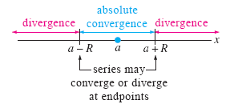

Slide 4
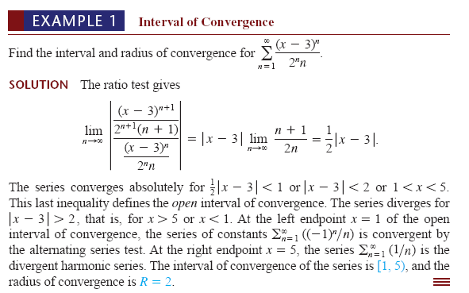

Slide 5
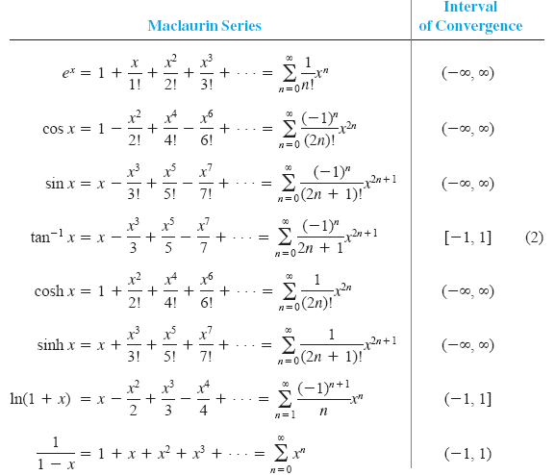

Slide 6





Slide 7
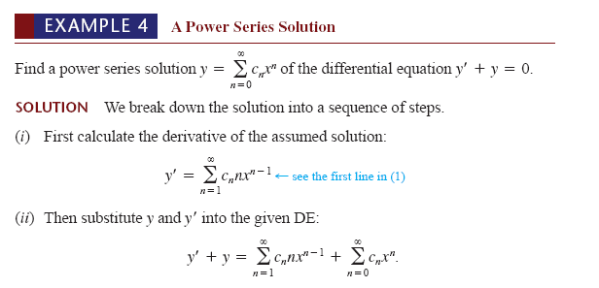

Slide 8
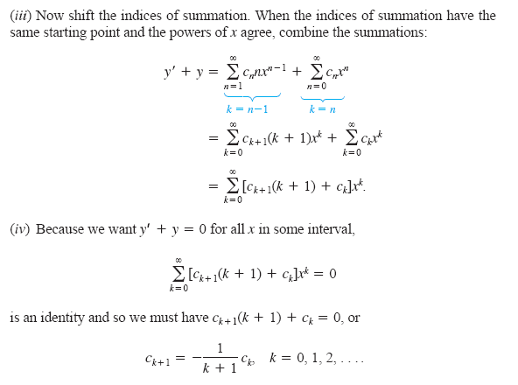

Slide 9
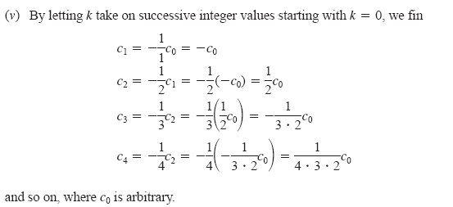

Slide 10
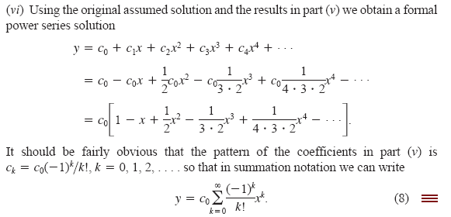

Slide 11



Slide 12




Example-1
Example-2

Slide 13

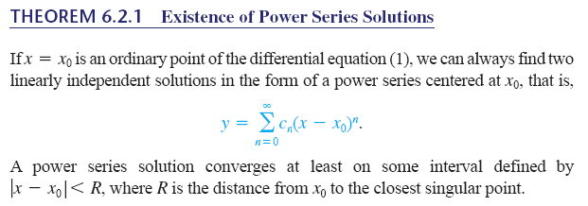

Example-3

Slide 14





(4)

Slide 15



Equating
(5)

Slide 16
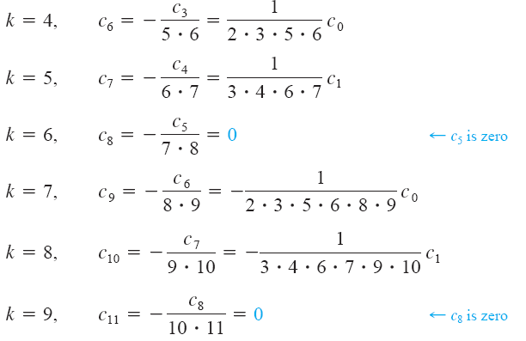

Slide 17



Slide 18




